Slide 1
DATABASE MANAGEMENT SYSTEM
LECTURE - 1

Slide 2

What is database
A database is just a way of storing and organizing data and processed to get information.
It is organized in such a way that it can be easily accessed, managed, and updated.

Slide 3


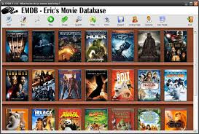


Applications of Database
Some Applications that actually use DBMS

Slide 4
Group Activity – Design database
Reservation of tables in a restaurant
Reservation of Books in a library
Managing your mobile phone address book with categories (friends, family, business, etc.)
Managing your family tree with all details
Reservation of seats for a reality show
Managing advertisements for your friends music performance
Managing exam time table
Managing your expenses with categories (academic, sports, entertainment, travel, etc.)
Managing your appointments (your calendar)
Managing your documents (digi locker)
Managing Important Events in your calendar (friends birthday, parents wedding anniversary, renewal of vehicle insurance, etc.)
Managing guests for an event (Ex: Inter Collegiate competition special guests)
Managing participants for a competition
Managing menu in a restaurant
Managing your workout schedules
Managing your mobile usage

Slide 5
Terminologies
Data ? -- Raw facts represented with alphabets, digits, special characters – No meaning to this
Ex: 10 – What it means is not clear unless associated with a unit as Rs. 10 or 10 AM etc – Associated with meaning data becomes information
Database ? (DB)– Organized way of storing the data – collection of inter related data stored together with controlled redundancy
Inter related data – data pertaining to one context or domain
Ex: Student DB need not have information on his property details, gadgets available, etc
Controlled redundancy – do not repeatedly store same data
Ex: Store only Reg. no and not name, class etc in all locations
Database Management ? (DBM) – Manage DB such add new details, modify details, delete, retrieve etc,
Database Management System ? – A software or a set of programs to perform DBM
Why ? – Ease of use for all actors involved (service provider, customer, administrator etc).

Slide 6
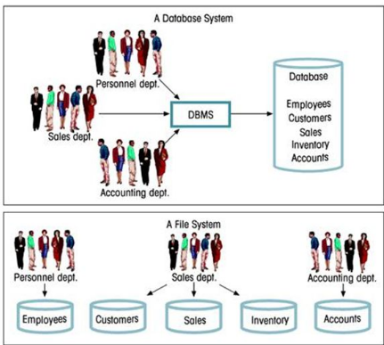
File vs DBMS

Slide 7
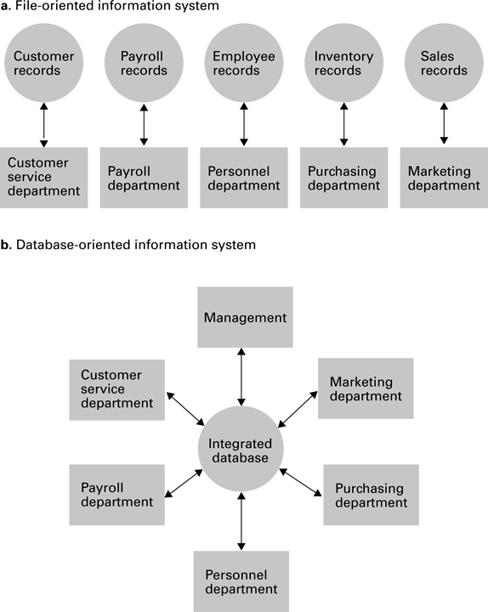
A file versus a database organization

Slide 8
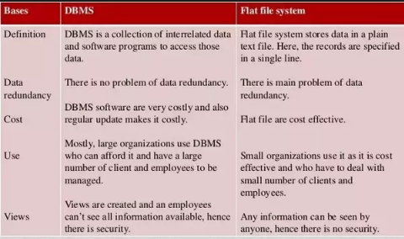
File vs Database

Slide 9
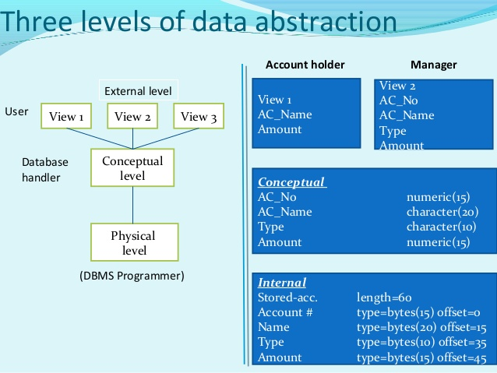
DATA ABSTRACTION
View level: What data users see
Conceptual level: What data is stored
Physical level: How data is actually stored

Slide 10
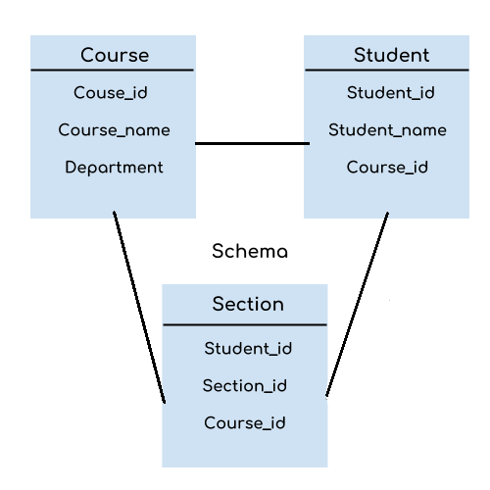
Schema and Sub Schema
A schema is a description of the entire database structure that is used by the database software to maintain the database.
A subschema is a description of only that portion of the database pertinent to a particular user’s needs.

Slide 11
Instances
Course_id | Course_name | department
19CSE101 | COMPUTER SYSTEM ESSENTIAL | CSE
15CSE302 | DBMS | CSE
15CSE180 | C PROGRAMMING | CSE
15MAT121 | LINEAR ALGEBRA | MATHS
INSTANCE
The data stored in database at a particular moment of time is called instance.
For example, lets say we have student table ,today the table has 100 records, so today the instance of the database has 100 records.
Tomorrow we add another 100 records ,so the instance of database tomorrow will have 200 records in table
How many instances are there in the course table given above? – One instance with 4 records

Slide 12
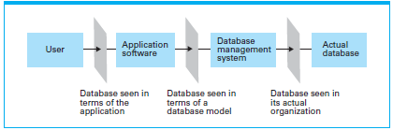
The conceptual level
A typical database application involves multiple software layers, categorized into two major layers—an application layer and a database management layer.
The application layer handles the communication with the user and the database.
Mobile User --- WhatsApp -- Manage groups – Actual DB (in phone)
(Application S/w) (DBMS) (Phone DB)

Slide 13
The conceptual layer
Once the application software has determined what action the user is requesting, it uses the DBMS as an abstract tool to obtain the results.
If the request is to add or delete data, it is the DBMS that actually alters the database.
If the request is to retrieve information, it is the DBMS that performs the required searches.

Slide 14
The conceptual layer – Advantages
DBMS and application software are separated
Abstraction : Need not know all details of the database the details of how the database is actually stored are isolated within the DBMS, the design of the application software can be greatly simplified.
Security: Access to the DB is controlled
Data independence: The ability to change the organization of the database itself without changing the application software. (Move from one Phone to another without loss of any data or anything new)

Slide 15
Advantages of DBMS
Minimize Data Redundancy
For example: A student record in college has to accesed by exam cell, Department, hostel , library etc can contain duplicate values, but when they are converted into a single database, all the duplicate values are removed. Data can be accessed from database

Slide 16
Advantages of DBMS
Sharing Of Data
Data can be shared between authorized user of database. All the users have their own right to access the database up to a level. Database Administration has complete access of database.
Eg: Read access- can only view the database
Students cannot access profile of teaching faculty for any updation in AUMS Write access – can view as well as make changes
Faculty can do updation of student mark in AUMS

Slide 17
Advantages of DBMS
Data consistency
By reducing data redundancy ensures, all copies of the data are kept consistent. Reduce updating errors
Eg: Any changes made in student A address should be same where ever Student A address is stored

Slide 18
Advantages of DBMS
Security
The data stored in DBMS is more secure as everyone don’t have permission to access the database. Some are given only to view data where as some are given privilege to manipulate the data base. So its more secure.
Eg: customers don’t have privilage to manipulate items listed out in online shopping website, while manipulation can be done in the items selected by the customer.

Slide 19
Disadvantages of DBMS
Database systems are complex, difficult, and time-consuming to design
Substantial hardware and software start-up costs
Damage to database affects virtually all applications programs
Extensive conversion costs in moving form a file-based system to a database system.

